Slide 1
Deep Learning
Generated for: RNNs, Deep Learning
Notes:
Welcome to the Deep Learning presentation covering multiple topics. Today we'll explore: RNNs, Deep Learning.

Slide 2
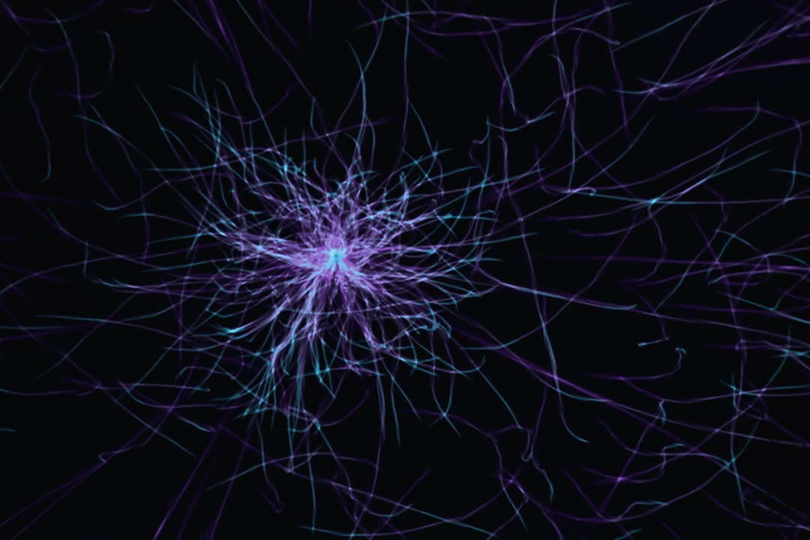
RNNs - Introduction
Recurrent Neural Networks process sequential data
RNNs have feedback connections for temporal relationships
Used for speech recognition and natural language processing
RNNs can learn from experience and improve over time
Basic RNN architecture consists of input, hidden, output layers
Vanishing gradients affect RNNs during backpropagation
RNNs are trained using backpropagation through time
Long Short-Term Memory networks address vanishing gradients
RNNs have applications in time series forecasting and prediction
RNNs can be used for sentiment analysis and text classification
Notes:
When introducing RNNs, explain the concept of sequential data and how RNNs process it. Provide examples of speech recognition and natural language processing. Discuss the basic RNN architecture and the challenges of vanishing gradients. Use the equation y = sigmoid(Wx + b) to illustrate the activation function. Ask students to consider how RNNs can be applied to real-world problems, such as time series forecasting and sentiment analysis. Key takeaways include understanding the strengths and limitations of RNNs and their applications in deep learning.

Slide 3

RNNs - Introduction
Recurrent Neural Networks process sequential data
Use feedback connections to capture temporal relationships
Suitable for speech, text, time series data analysis
Trained using backpropagation through time algorithm
RNNs have internal state to store information
Vanishing gradients affect RNN training stability
Simple RNNs struggle with long-term dependencies
Used in language modeling, machine translation tasks
RNNs are basis for more complex models like LSTMs
Effective in handling variable-length input sequences
Notes:
When introducing RNNs, emphasize their ability to handle sequential data and their internal state. Explain the concept of backpropagation through time and how it affects training. Provide examples of applications such as speech recognition and language modeling. Discuss the challenges of vanishing gradients and long-term dependencies. Ask students to consider how RNNs can be applied to real-world problems and what advantages they offer over other neural network architectures. Key takeaways should include understanding the basic architecture of RNNs and their limitations.

Slide 4
RNNs - Introduction
Recurrent Neural Networks process sequential data
RNNs have feedback connections, allowing memory
Used for speech recognition, language modeling
RNNs learn patterns in time series data
Input, output, and hidden layers are key
Backpropagation through time is used for training
Vanishing gradients affect RNN performance
Long Short-Term Memory solves this issue
RNNs can be unidirectional or bidirectional
Simple RNNs are foundation for more complex models
Notes:
When introducing RNNs, emphasize their ability to handle sequential data and their application in speech recognition and language modeling. Explain the basic architecture, including input, output, and hidden layers. Discuss the challenge of vanishing gradients and how LSTM helps mitigate this issue. Provide examples of unidirectional and bidirectional RNNs and ask students to consider scenarios where each would be more appropriate. Key takeaways include understanding the role of feedback connections and the importance of addressing vanishing gradients in RNN design.

Slide 5
Deep Learning - Introduction
Deep learning is a subset of machine learning algorithms
Inspired by the structure and function of the brain
Uses artificial neural networks to analyze data
Enables computers to learn from experience
Improves performance with more data and computing power
Key applications include image recognition and speech analysis
Deep learning techniques include convolutional and recurrent networks
Requires large datasets and significant computational resources
Used in self-driving cars, facial recognition, and language translation
Enhances decision-making capabilities in various industries
Notes:
When teaching this slide, start by introducing the concept of deep learning and its relation to machine learning. Provide examples of how deep learning is used in real-world applications, such as image recognition and speech analysis. Emphasize the importance of large datasets and computational resources in deep learning. Ask students to consider the potential applications and limitations of deep learning in various industries. Key takeaways include the concept of artificial neural networks, the importance of data and computing power, and the potential impact of deep learning on decision-making capabilities.

Slide 6
Deep Learning - Introduction
Deep learning is a subset of machine learning methods
Inspired by the structure and function of the brain
Uses artificial neural networks with many layers
Enables computers to learn from data without programming
Can learn from large amounts of data automatically
Used in image and speech recognition applications
Requires significant computational power and data
Has many applications in industry and research
Includes techniques like convolutional and recurrent nets
Notes:
When introducing deep learning, explain that it's a type of machine learning that uses neural networks with multiple layers to learn from data. Provide examples of applications such as image recognition, speech recognition, and natural language processing. Ask students if they have any experience with machine learning or neural networks. Discuss the importance of large datasets and computational power in deep learning. Key takeaways include understanding the basics of deep learning and its applications, and recognizing the differences between deep learning and other machine learning methods.

Slide 7
Deep Learning - Fundamentals
Deep learning is a subset of machine learning methods
Inspired by structure and function of human brain
Uses artificial neural networks with multiple layers
Trained by minimizing loss function using backpropagation
Can learn complex patterns in large datasets
Applications in image and speech recognition
Requires significant computational resources and data
Key concept: representation learning and abstraction
Enables automatic feature extraction and learning
Notes:
When discussing deep learning fundamentals, emphasize the inspiration from the human brain and the use of artificial neural networks. Explain that deep learning is a subset of machine learning and highlight its ability to learn complex patterns. Provide examples of applications such as image recognition, speech recognition, and natural language processing. Ask students to consider the limitations and challenges of deep learning, including the need for large datasets and significant computational resources. Key takeaways include understanding the concept of representation learning and the ability of deep learning models to automatically extract features from data.

